Slide 1

CAPSTONE #1
Traktor TEK Sales Data Analysis
Presented by: Paola Ignatova
04/14/2021

Slide 2
Overview
Web UI:
Web App UI – weekly sales entries by product and team
Sends data to an app sales table in the database which copies entries to the main sales table through SQL triggers
Dashboard: ​
Focal points: sales by region and by team
Slicers filter data by year and by quarter
Product sales comparison by team
Database Design
One Sales Fact Table and 4 Dimension Tables
Sales table tracks sales by year and week
Product is divided into a price table and a product description table
Sales period table is for time reference only, it is not included in the analysis
Main analysis table is created through a SQL query to be used in EXCEL for creating dashboards

Slide 3
1 . UI

Slide 4
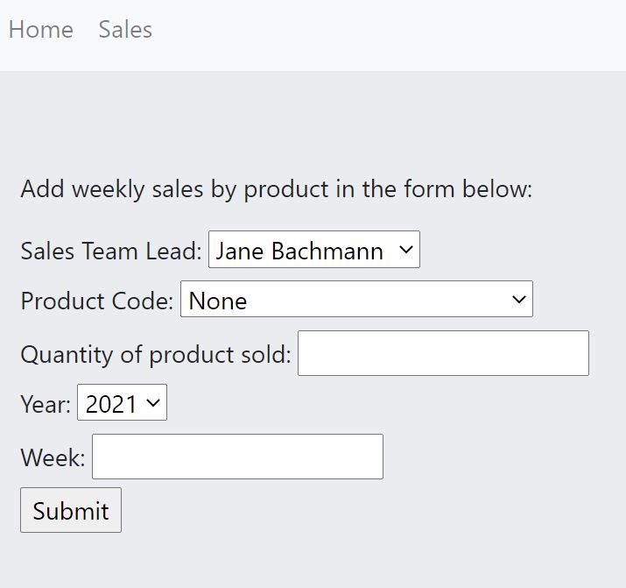
UI
Database Design
Select Team Lead
Select Product Code
Select quantity, year and week
Sales data is loaded into an app sales table which populates the corresponding fields in the main sales table through SQL triggers

Slide 5
UI Challenges and Solutions
Functionality and Design
The ability to choose more than one product in the same session
Connection between product and warranty sold
Validators to check user input and send messages to prompt for the correct type of entry
On the back end – calculations for time periods to populate necessary fields in the main sales table
Send the sales data to the main sales table through SQL triggers
Design choices to match the overall brand

Slide 6
2 . Dashboard

Slide 7
Dashboard Challenges & Solutions
Telling more than one story
One main analysis table is feeding the RAW data to EXCEL
Several Pivot Tables are driving different views of the analysis
Slicers for Year and Quarter filtering are connected to all pivot charts
Category grouping allows for switching between products and warranties
Connection between products and their respective warranties
Design choices to match the brand style guides

Slide 8
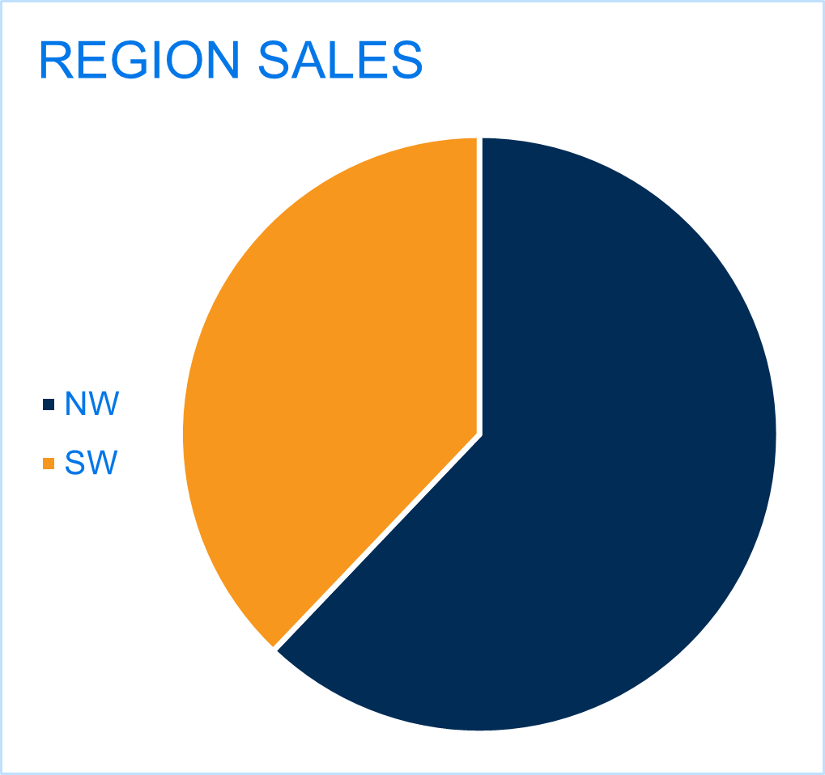
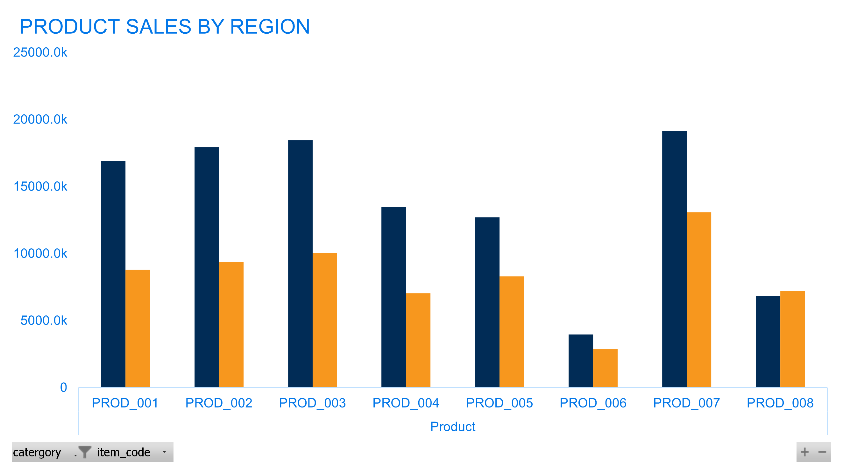
Traktor TEK Sales Dashboard
Sales by product, team and region is the main focus of the analysis

Slide 9
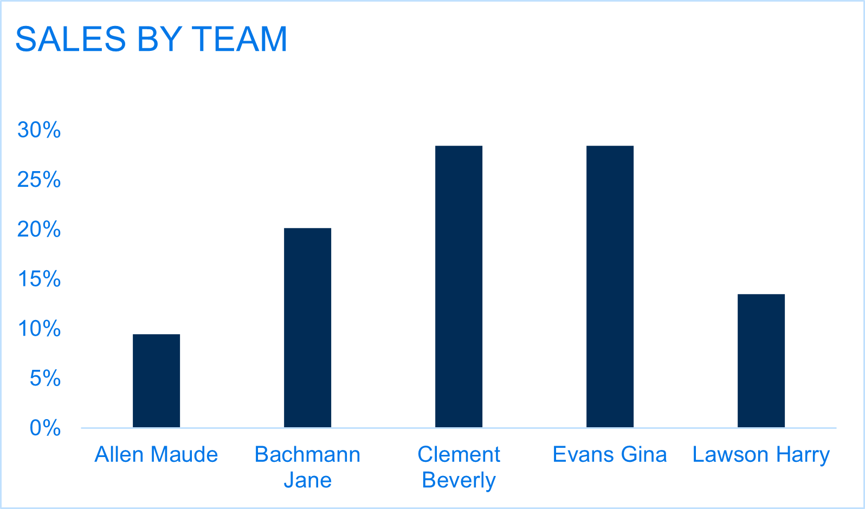
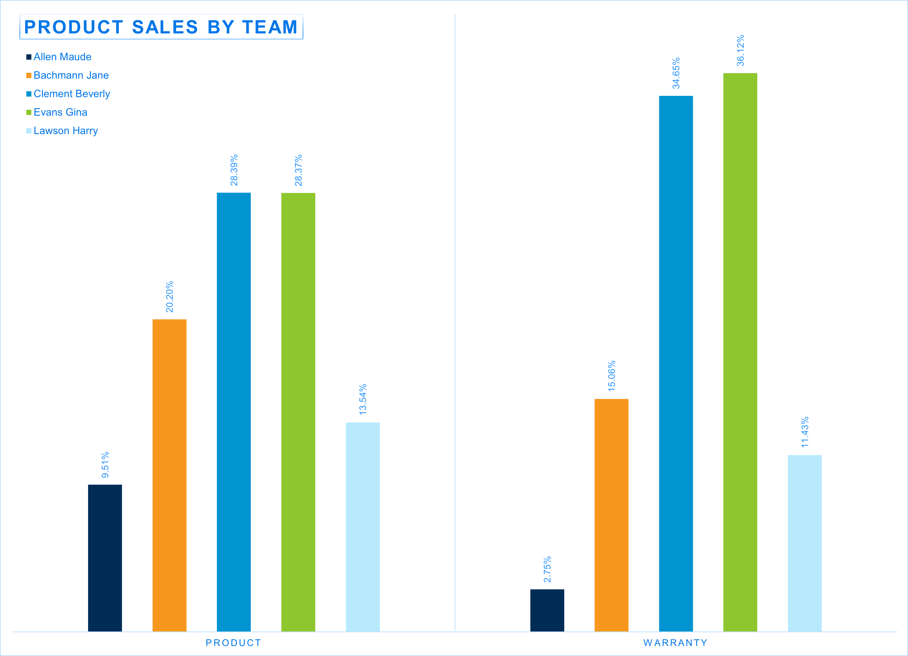
Traktor TEK Sales Dashboard
Overall sales by team and broken down by product

Slide 10
Sales Analysis
Trends and Conclusions
Regions : The NW region is accounting for almost 2/3 of the sales
Teams: there are two teams that are accounting for nearly 60 % of all sales and performing almost 2.5 times better than the teams selling the least amount of products
Time: sales follow a consistent pattern overall. Although data is limited to only 2 years.
Products: 4 products perform well in comparison, 2 perform very weakly (prod 6 and prod 8). Product 7 is the best performing product.
Warranties: account for very small percentage of overall sales. Need improvement

Slide 11
3 . Database Design

Slide 12
Database Challenges & Solutions
Functionality and Simplicity
Simple snowflake schema or modified Star
There is still one main fact table – Sales which is the focal point of transactions as well as analysis
3 main Dimension Tables – Sales Team, Product and Unit Price that connect with Sales to create one main OLAP table for data analysis
App Sales table to copy entries from UI to Sales Fact Table
Sales Period Table for reference only
Price is changing by sales year and quarter
Each product has its respective warranty
Historical data clean up and prep

Slide 13
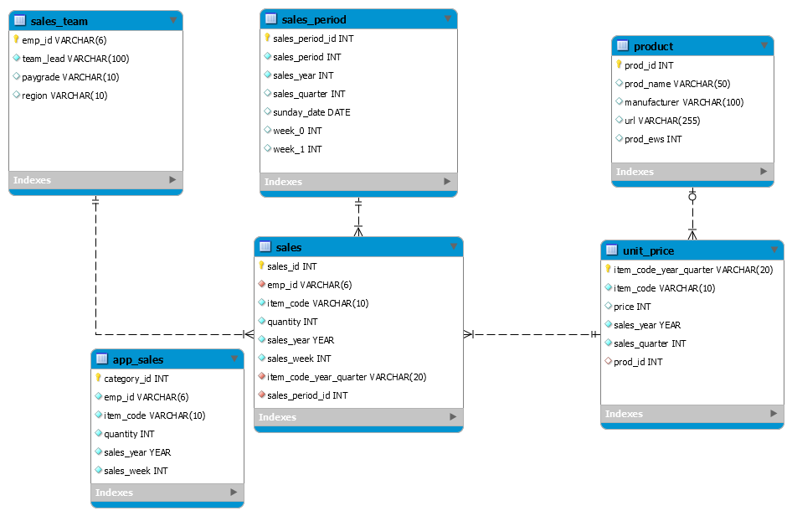
EER Diagram

